Slide 1
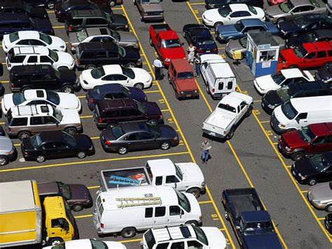

PROBLEM

Slide 2


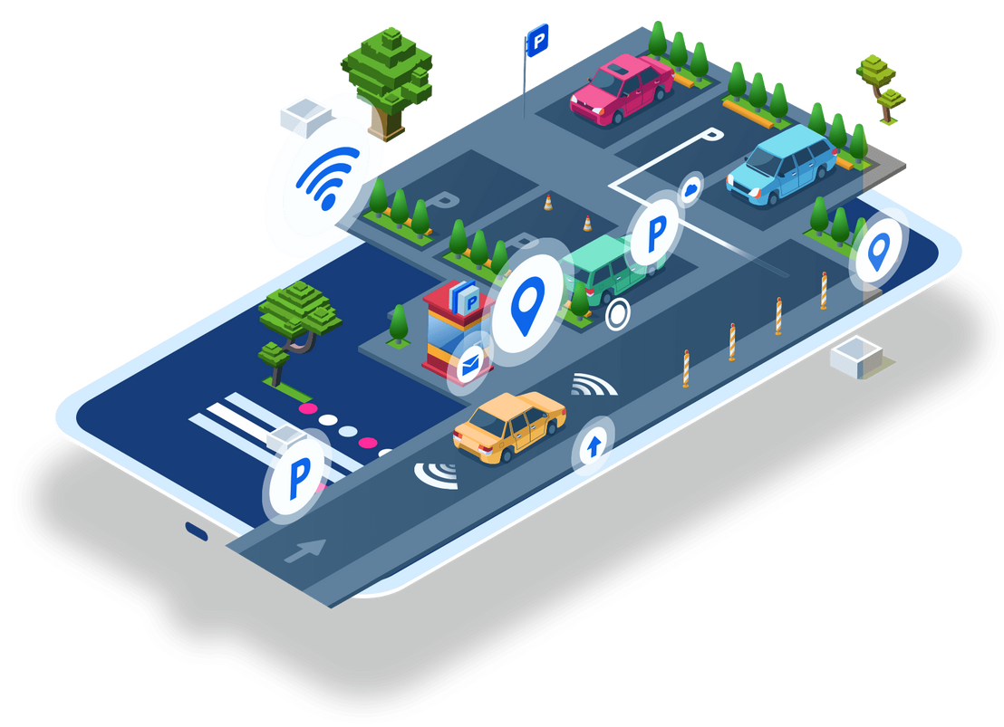


SLIOT Challenge 2025
ParkSense - IoT Enabled Smart Parking System
The Sentinals

Slide 3

Functionality of
ParkSense

Slide 4


Solution Architecture
Slot Indication
Vehicle and Number Plate Detection
Website Reservation
Vehicle Detection Using Sensors
Dynamic Billing

Slide 5

User Identification

Slide 6
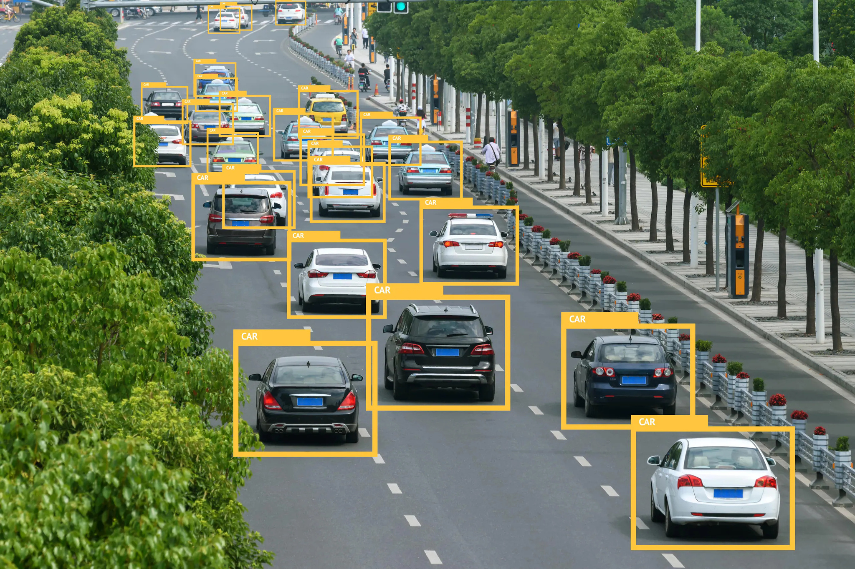
Vehicle Detection

Slide 7
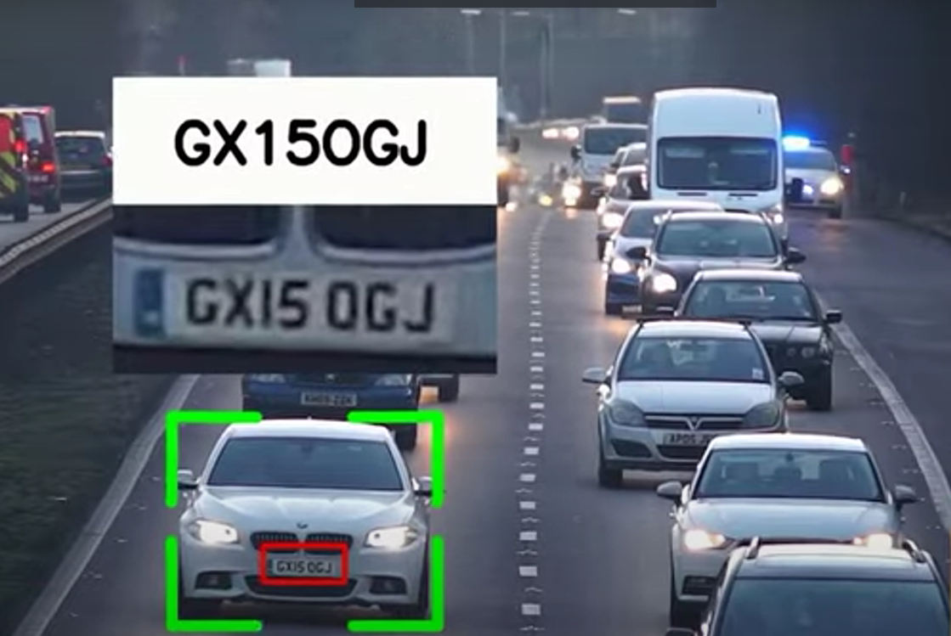
Number Plate Identification

Slide 8
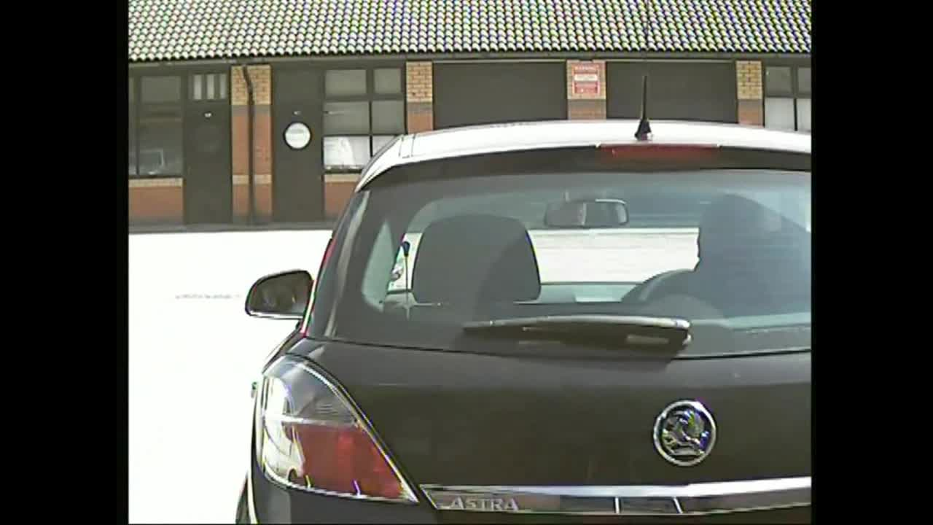

Slide 9
ParkSense Website

Slide 10
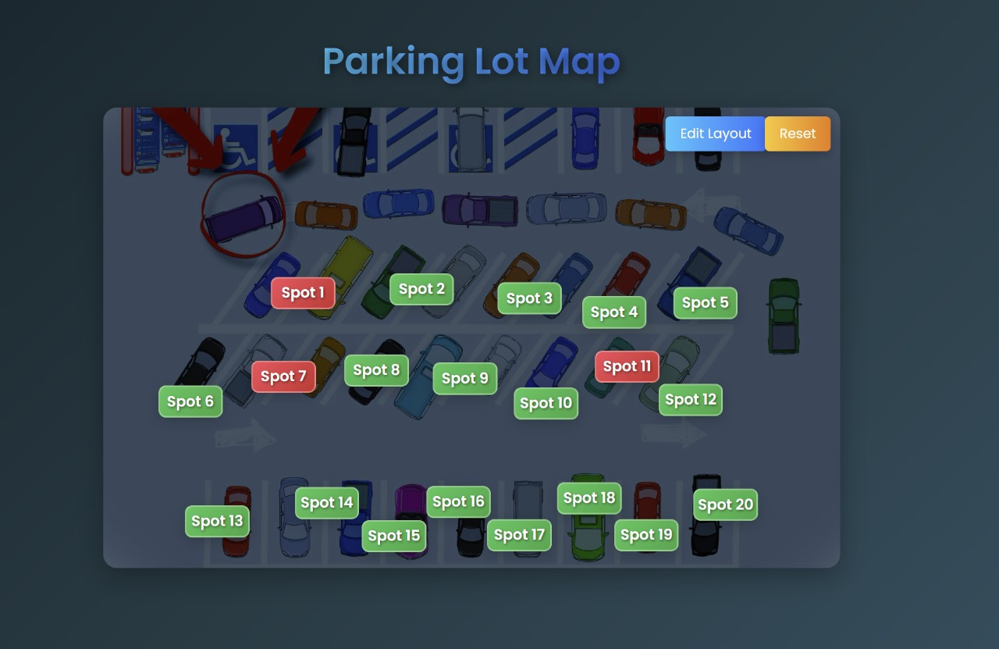
Display at the Entrance

Slide 11
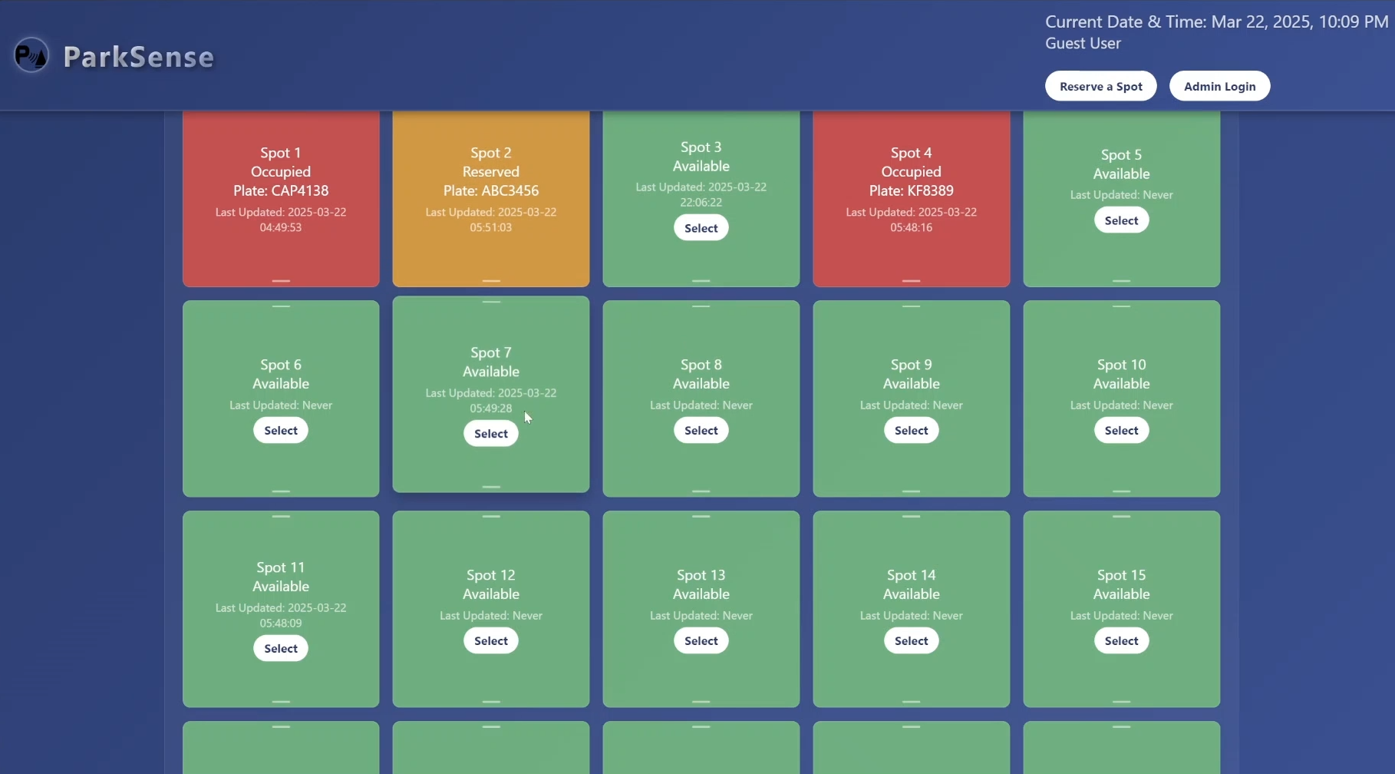
IInteractive User Display

Slide 12
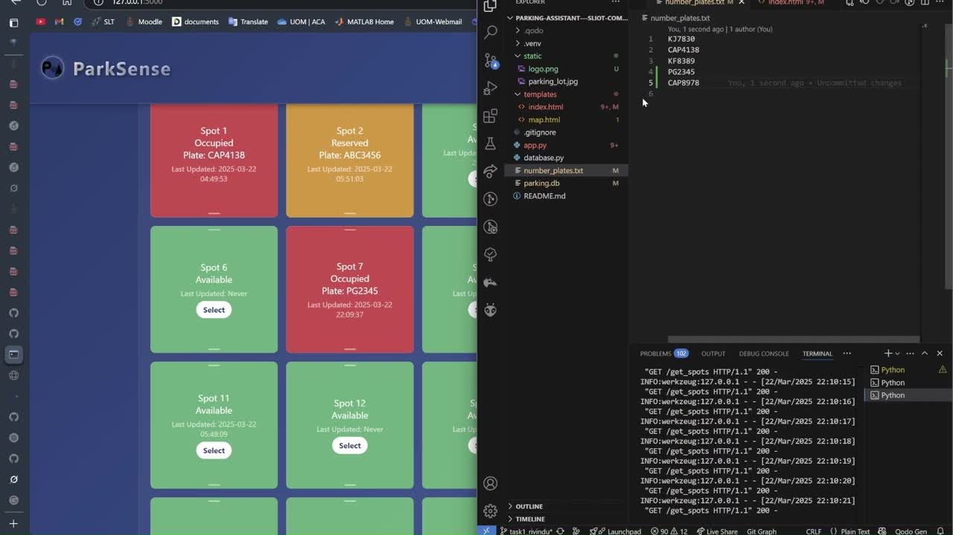

Slide 13
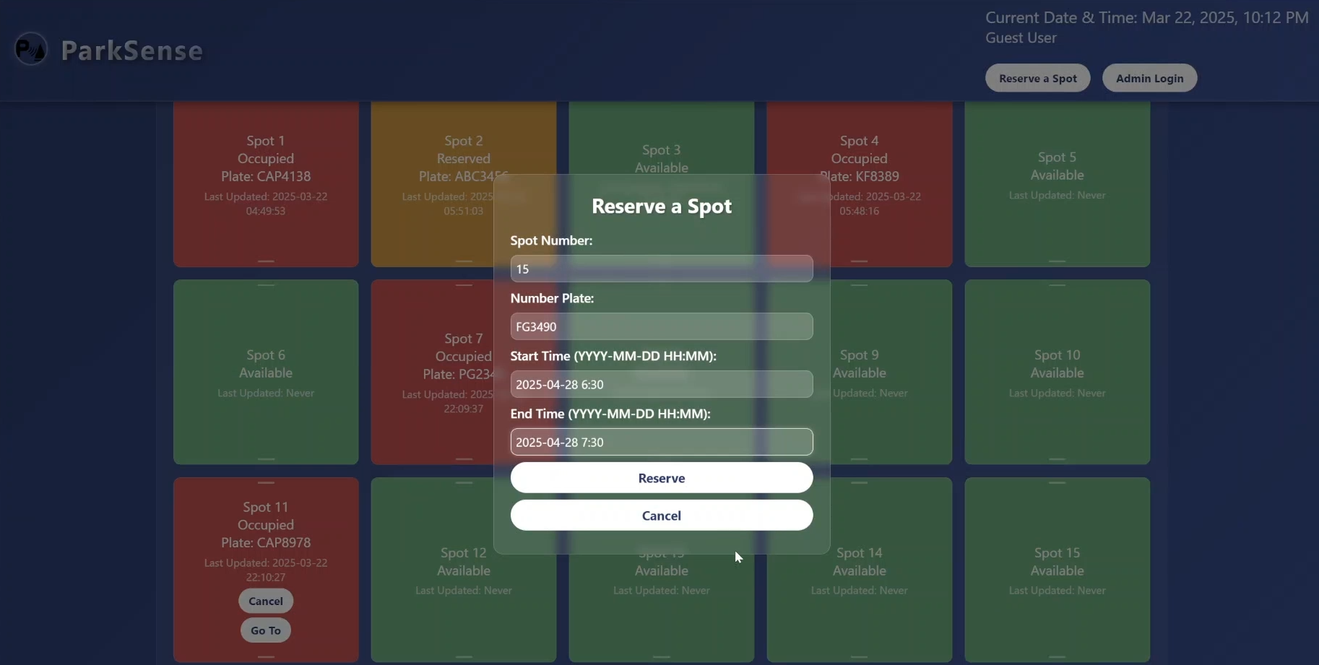
Reservation

Slide 14
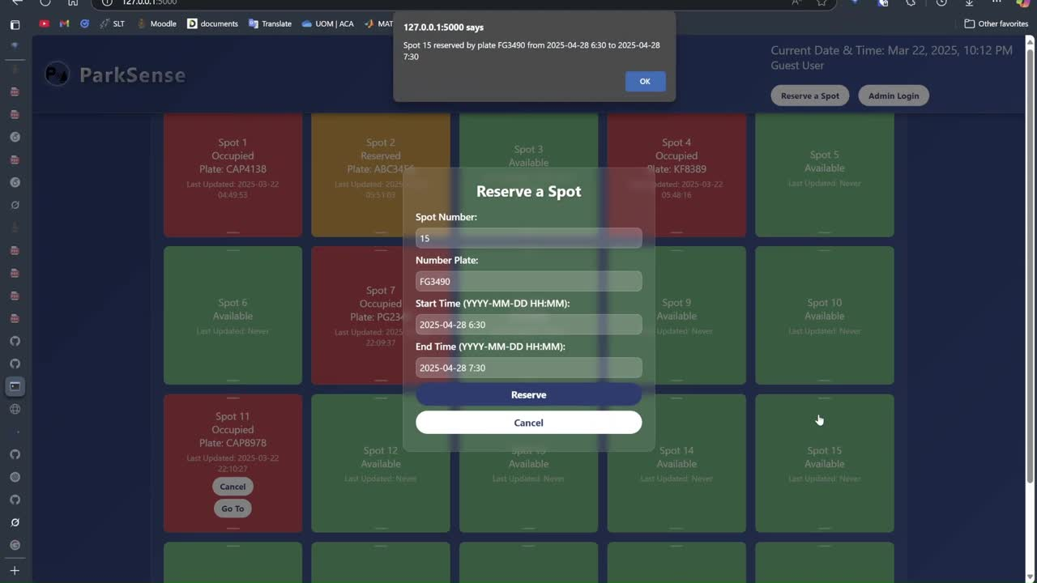

Slide 15
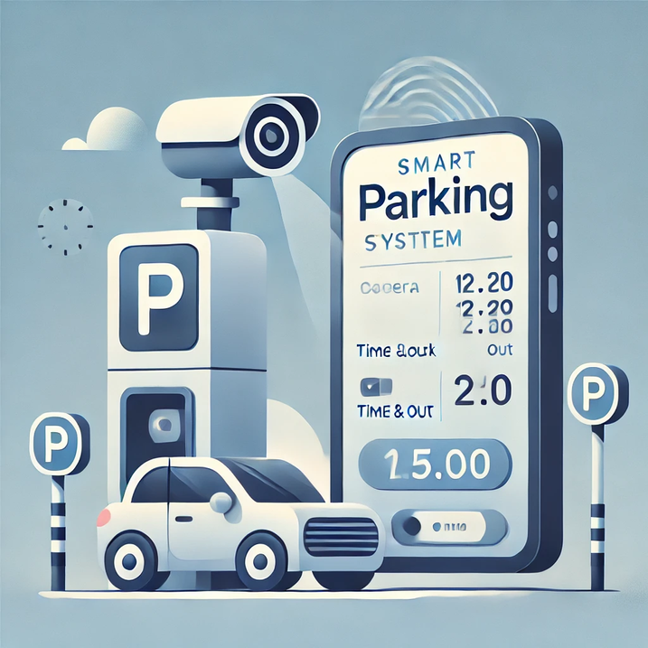
Fee calculations
On-the-spot arrivals:
Fee = Rate for vehicle × (Exit Time - Entry Time)
Fixed-Time Reservations:
Pre-paid fixed fee for reserved duration.
Extra fee applied if overstaying:
Extra Fee = Rate × Overstayed duration
Open-Ended Reservations:
Nominal booking fee upfront.
Usage Fee = Rate × (Exit Time - Actual Entry Time)
Total Fee = Booking Fee + Usage Fee
Through licence plate recognition...
Matches vehicle to reservation at entry.
Handles no-shows and cancellations automatically.

Slide 16
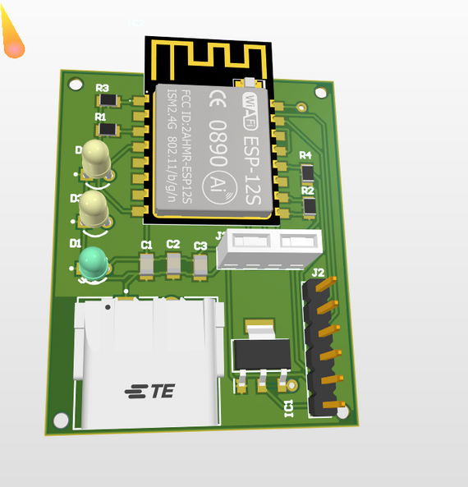
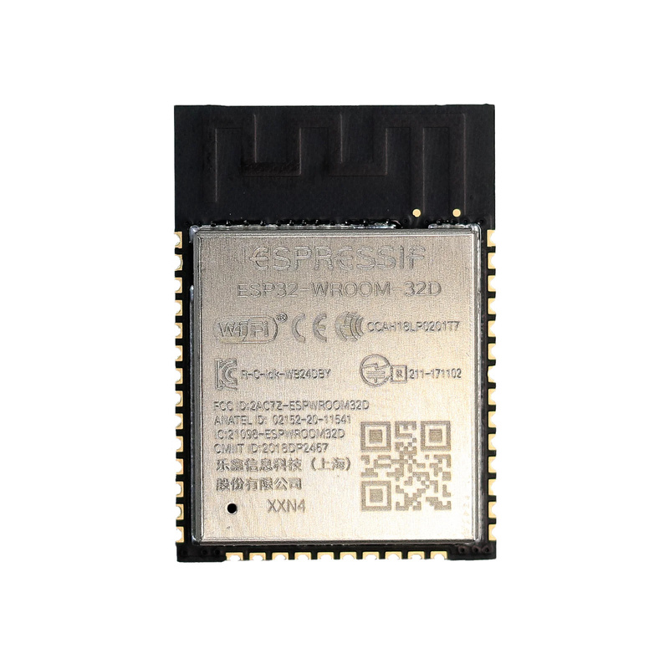
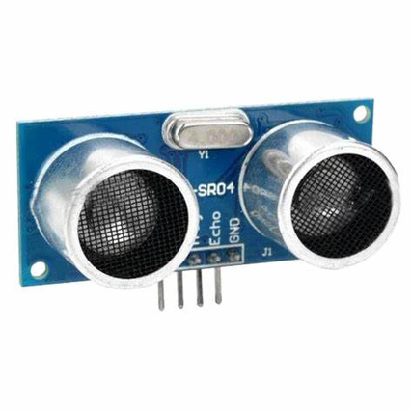
Sensors at Parking Spots
Ultrasonic Sensors
ESP32 MCU
Server
MQTT Protocol
Sensor Module PCB

Slide 17
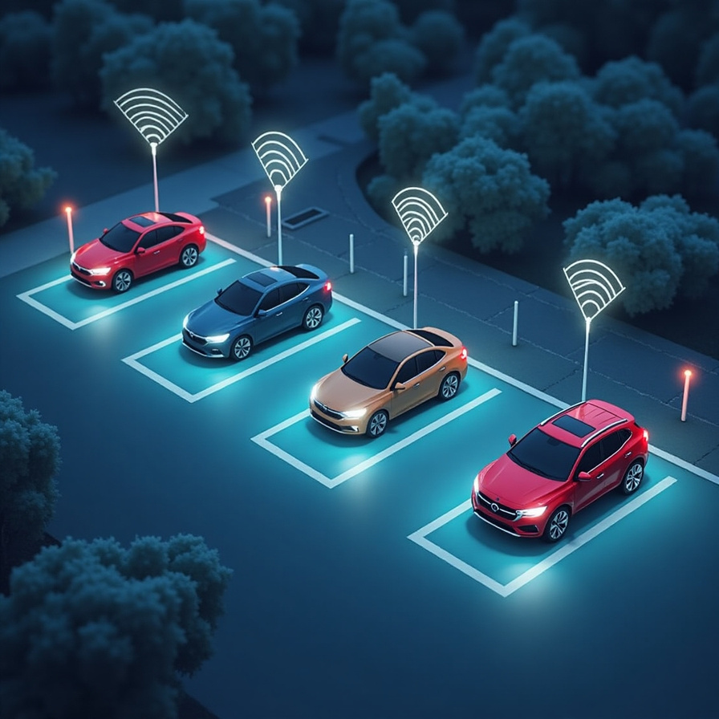
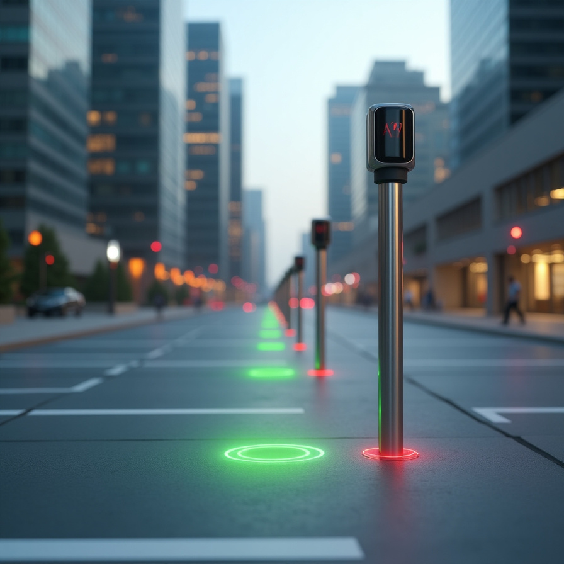

Slide 18

Scalability
Scalability

Slide 19
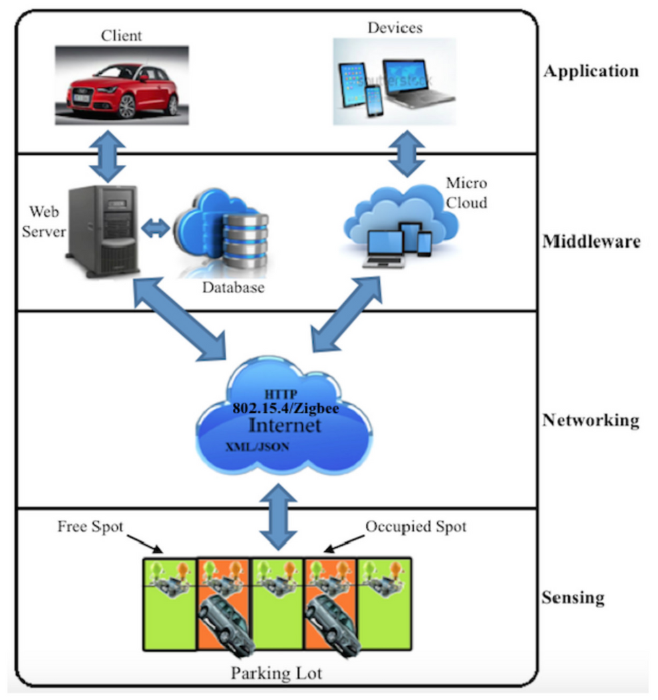
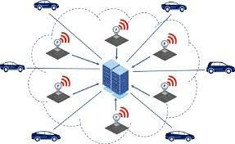
Modular Architecture
Distributed Sensor
Network

Slide 20

Cloud Integration & Data Analytics

Slide 21

INDUSTRIAS ARIOVA
Flexibility

Slide 22
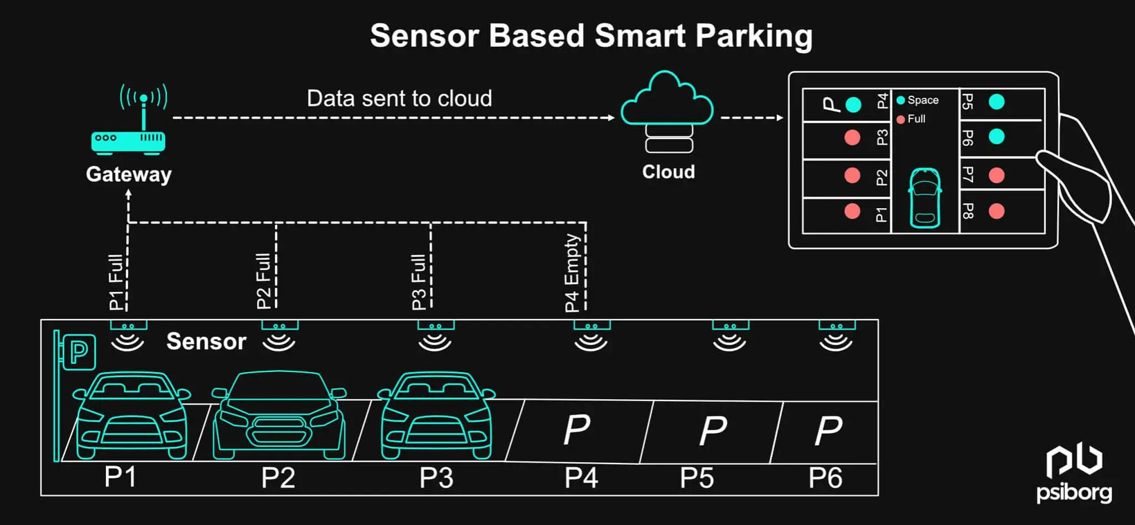
Adaptable Hardware & Software
User-Centric & Customizable Experience
Dynamic Resource Allocation
Future-Proof Design

Slide 23


Deployment
Hardware Installation :
Placement of ultrasonic sensors at each parking spot
Installation of cameras at entry and exit points
Integration of ESP32 microcontrollers for wireless data transmission.
Software and Cloud Integration
Development of a cloud-based server
Web application for users to view, reserve, and pay for parking.

Slide 24


Risk Assessment and Mitigation
Technical Risks
Sensor malfunctions and poor network connectivity.
Regular maintenance, redundant communication channels
Data Security & Privacy Risks
Unauthorized access to system.
End-to-end encryption, secure authentication
User Adoption & Behavioral Risks
Resistance from traditional parking operators or users unfamiliar with digital systems.
User-friendly interfaces, educational campaigns

Slide 25

Viability
Market Demand & Adoption
Growing urban congestion increases the demand for smart parking solutions.
Economic Feasibility
Revenue generation through parking fees, subscription models, or advertising.
Technical Feasibility
Leverages proven IoT, AI, and cloud computing technologies.
Scalable deployment using MQTT-based wireless communication.

Slide 26


MARKETING

Slide 27

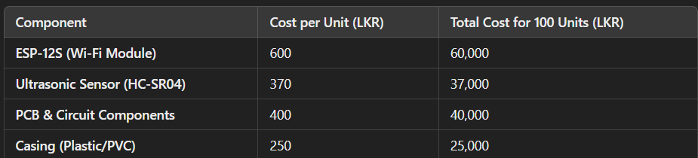

Budget

Slide 28


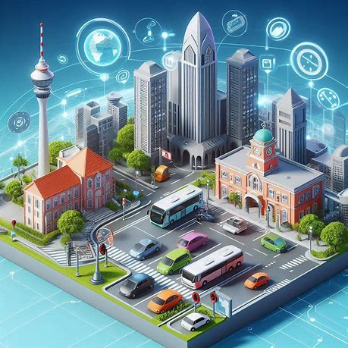

Market Analysis
Why Smart Parking in Sri Lanka?
High Demand: Colombo and major cities face severe parking shortages; over 500,000 vehicles enter Colombo daily, leading to significant congestion.
Strong User Base: Rising adoption of digital payments and mobile apps; increasing comfort with technology-driven solutions post-pandemic.
Government and Institutional Support: Active municipal initiatives towards smart city projects and parking management improvements.

Slide 29
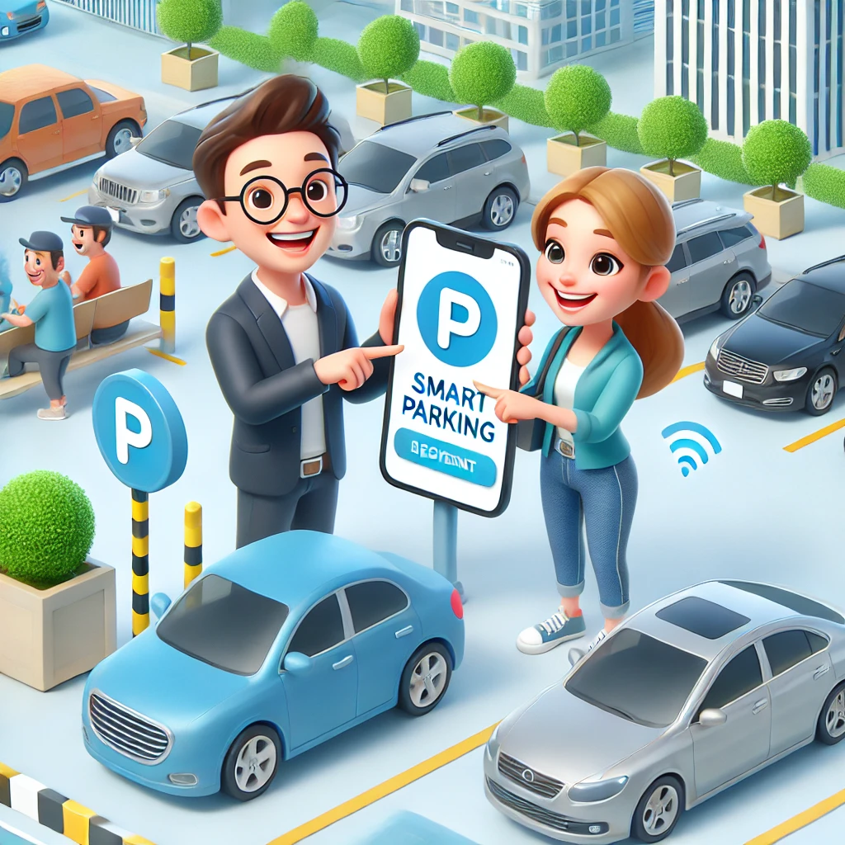
Target &
Growth Opportunities
Target audience:
Urban Commuters
Commercial Establishments
Municipalities & Parking Operators
Opportunities:
Rapid urbanization
Environmental Sustainability
Smart City Integration
Technological Adoption
Strategic Collaborations

Slide 30




Marketing Strategy
A mix of digital and local channels ensures we reach both tech-savvy commuters and key decision-makers directly, building trust and visibility where it matters most.
Collaborating with local businesses
Placing ads in busy urban locations
Local Advertising
Digital Marketing
Social media
Targeted online ads
Engaging with city municipalities and private parking operators
Partnerships

Slide 31
WHY US?

Slide 32





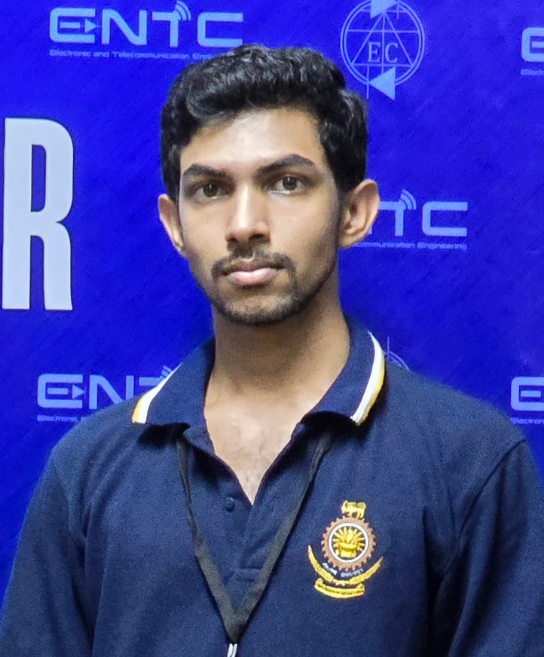




Our Team
Thevindu Kalubovila
Rivindu Kumarage
Anjana Viduranga
Tharindu Rathnayake
Sayuru Jayasekara

Slide 33

THANK YOU

Slide 34
Q&A

